Slide 1

Shri Vaishnav Vidyapeeth Vishwavidyalaya
Shri Vaishnav Institute of Information Technology
Department of Computer Science and Engineering
Session: - 2021-22
Subject: - Scripting Language
Subject Code: - BTCS-607
Project Topic: - Gaming Website
Submitted By:-
Aviral Jain (19100BTCSAII05250)
Divyam Pithawa (19100BTCSAII05259)
Mradul Agrawal (19100BTCSAII05269)
Rudraksh Thorat (19100BTCSAII05280)
Sarthak Nahar (19100BTCSAII05283)
Shivam Sharma (19100BTCSAII05286)
Submitted To: -
Prof. Avdesh Kumar Sharma
Class: -
CSE-C(AI-IBM)

Slide 2
Content
Introduction
Problem Statement
What is the idea?
Motivation Behind
Technologies Used
Implementation and User Interface
Conclusion

Slide 3
Introduction
This project is aimed at developing a website for online gaming. The Online Gaming Zone provides an easy interface that would let the users to access the pool of various online web games. It provides the user more pleasure and gladdening his mind by playing these games without any download or any installation in users physical memory. It also provides users to interact with any game as it is open source website with no encryption done till now. Users can play and access these games in any physical device with different configurations. Basically, the website consists of many games.

Slide 4

PROBLEM STATEMENT
What are we creating
We are creating “A real-time Live Online Gaming website.”
The problem statement is to propose a system that is meant to give more easiness to the users that they can easily access to the games.
Also, to provide various games options for a user

Slide 5

What is the Idea ?
In today’s era, we all are aware of our daily changing requirements and the need to entertain as in this world of full of tasks and jobs.
Online Gaming via this interface make us elevate from being digitally literate to digitally fluent, collaborate using appropriate virtual tools and system and that are cost-effective and environment friendly too. So, putting our efforts into this application, we are going to create “Games Khelo”.

Slide 6

Motivation Behind.…
Gaming gives relaxation and enjoyment to every user. In this busy world, gaming is the solution to release the depression and tension. Social networking with gaming is a nice combo for any user who feels relaxed in playing games. The requirements specified in this document will be used for designing all the aspects and components of the game. The document will be updated as the requirements grow and change over the design and development process.

Slide 7

Technologies Used
For the completion of the task the following Web-languages and scripts have been used:
HTML
CSS
JavaScript
PHP
MySQL

Slide 8
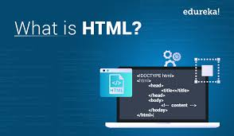
HTML
HTML stands for Hypertext Markup Language, and
it is the most widely used language to write Web Pages.
Hypertext refers to the way in which HTML documents are linked together.
Thus, the link available on a webpage is called Hypertext.
As its name suggests, HTML is a Markup Language which means you use HTML to simply "mark-up" a text document with tags that tell a Web browser how to structure it to display.
HTML is being widely used to format web pages with the help of different tags available in HTML language.
HTML is the language for publishing web pages on the WWW (World-Wide Web).
HTML is a Document Description Language (aka Document Markup Language).
HTML is NOT a programming language like C/C++/C#/Java, which is used to implement programming algorithm.
You need a web browser to view the HTML pages. The web browsers do not display the HTML tags, but uses the tags to interpret the content of the web pages.
An HTML document is a text document, and it is human-readable

Slide 9
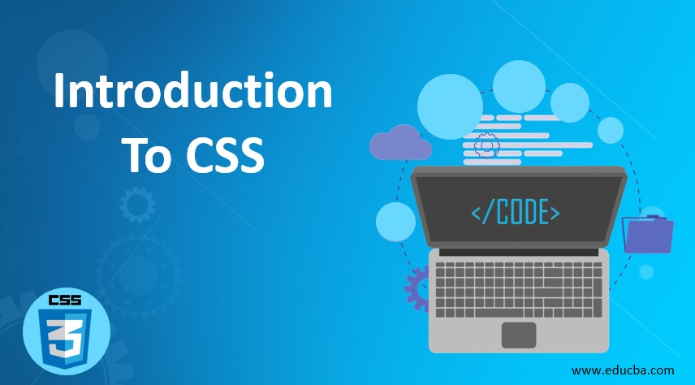
CSS
CSS is acronym for Cascading Style Sheets and is a markup language
responsible for how your web pages will look like.
It controls the colors, fonts, and layouts of your website elements.
It is a style sheet language used for describing the presentation of a document written in a markup language like HTML. CSS is designed to enable the separation of presentation and content, including layout, colors, and fonts.
CSS has a simple syntax and uses a number of English keywords to specify the names of various style properties.
A CSS comprises of style rules that are interpreted by the browser and then applied to the corresponding elements in your document.
Each rule or rule-set consists of one or more selectors, and a declaration block.
A style rule is made of three parts :−
Selector − A selector is an HTML tag at which a style will be applied. This could be any tag like <h1> or <table> etc.
Property − A property is a type of attribute of HTML tag. Put simply, all the HTML attributes are converted into CSS properties. They could be color, border etc.
Value − Values are assigned to properties. For example, color property can have value either red or #F1F1F1 etc.

Slide 10

JavaScript
JavaScript is a client-side scripting language and used to build interactive,
Websites with dynamic features and to validate form data.
JavaScript is high-level, dynamic and browser interpreted programming language, supported by all modern web browsers.
Apart from web browser, JavaScript is also used to build scalable web applications using Node JS. JavaScript is also being used widely in game development and Mobile application development.
JavaScript is also known as the Programming Language of web as it is the only programming language for Web browsers. JavaScript is an object-based scripting language which is lightweight and cross-platform.
The programs in this language are called scripts. They can be written right in a web page’s HTML and run automatically as the page loads. Scripts are provided and executed as plain text. They don’t need special preparation or compilation to run.
The browser has an embedded engine sometimes called a “JavaScript virtual machine”.

Slide 11

Implementation And User Interface (UI):

Slide 12
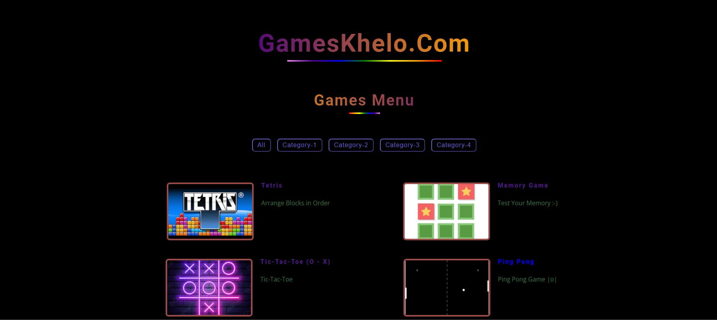
This is the main interface of our Gaming Website.
Website is displayed by a name of Games Khelo

Slide 13
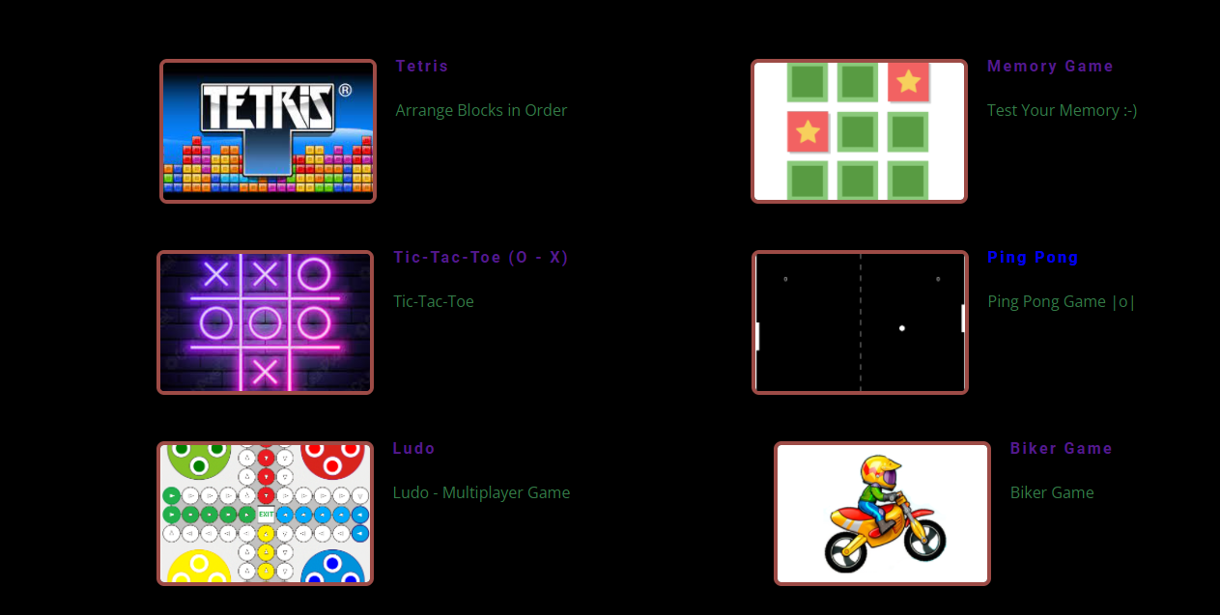
These are the games Uploaded on our Website ,User can access them directly by clicking on the image icons.
Also no need to install any external setup or Gaming environment.

Slide 14
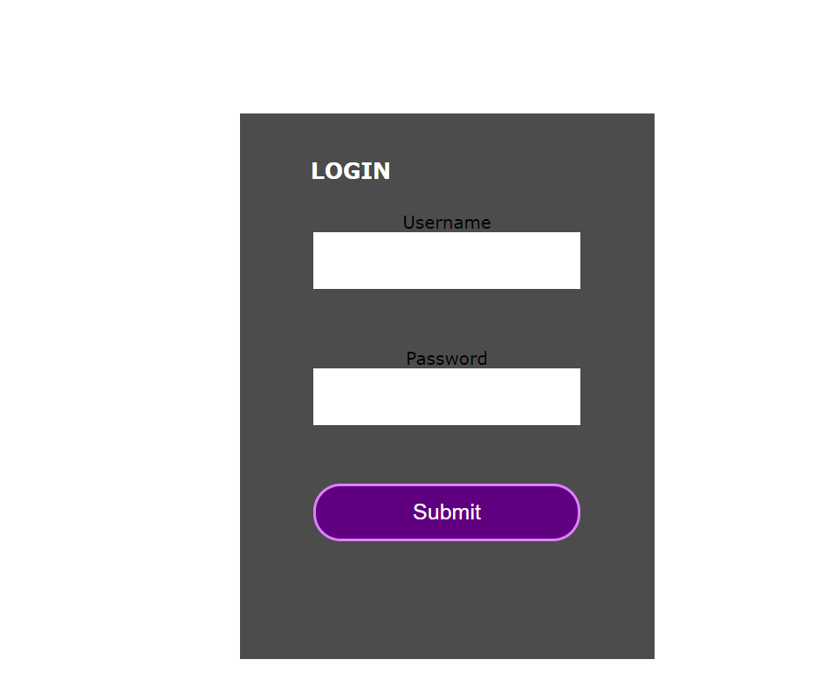
tHIs is the login page of our website

Slide 15
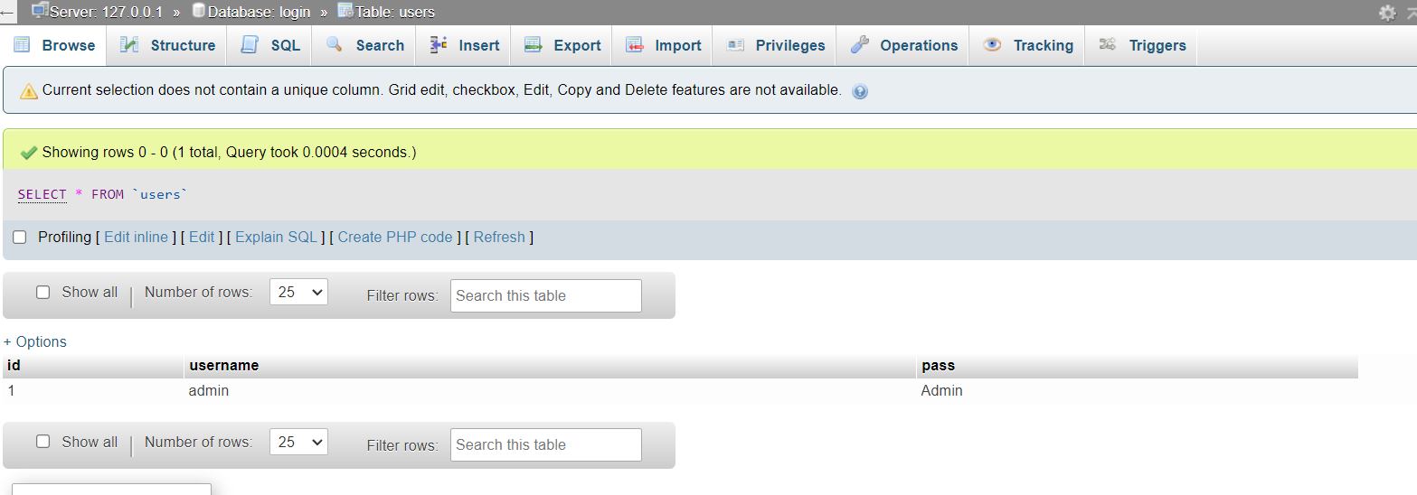
After Entering Correct “USERNAME” and “PASSWORD” It validates the credentials to the values which are present on server.
And if the credentials are correct the user is redirected to the main Landing page
We have achieved this functionality using MySQL and PHP

Slide 16
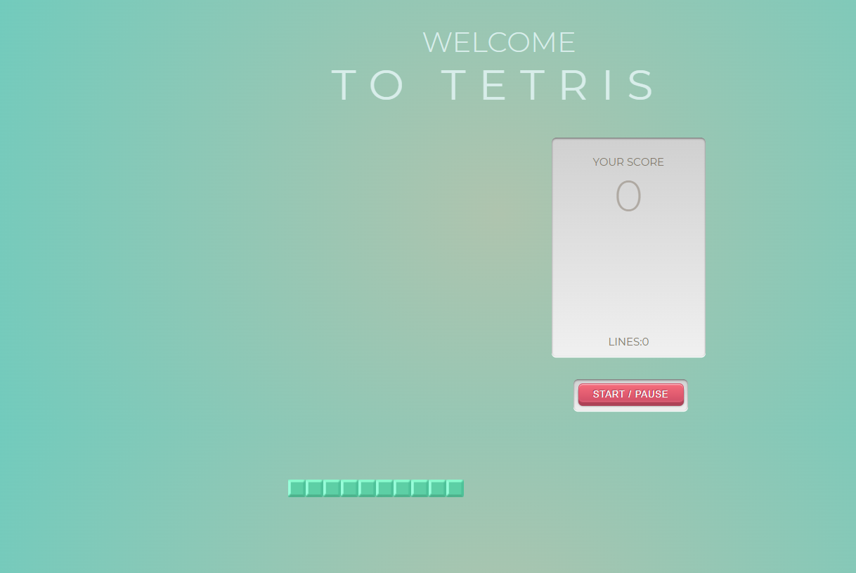
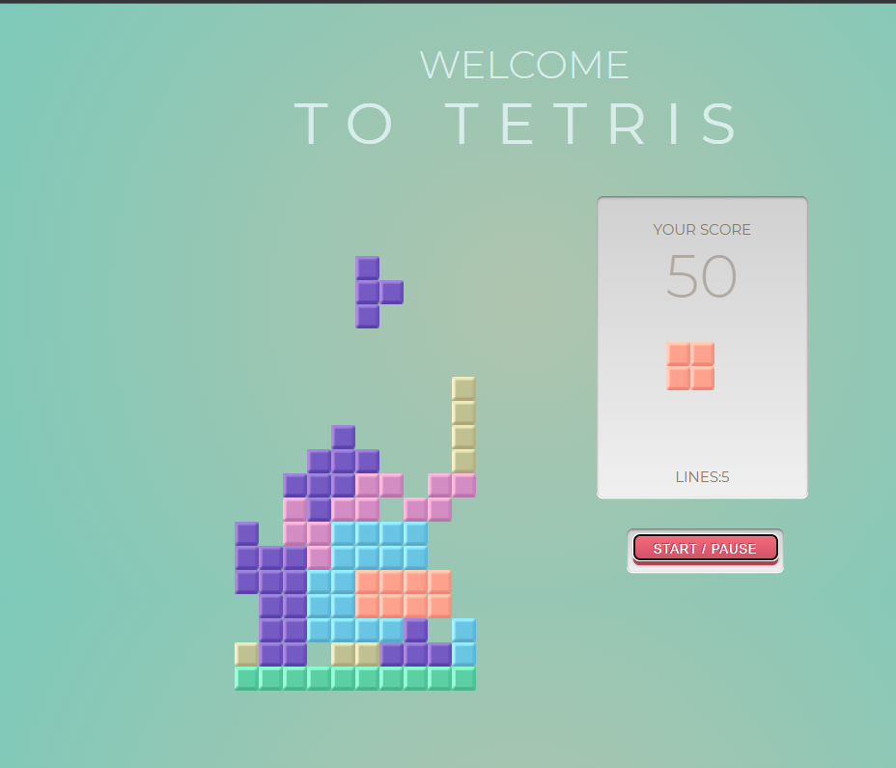
This is our First Game Uploaded on our website .

Slide 17
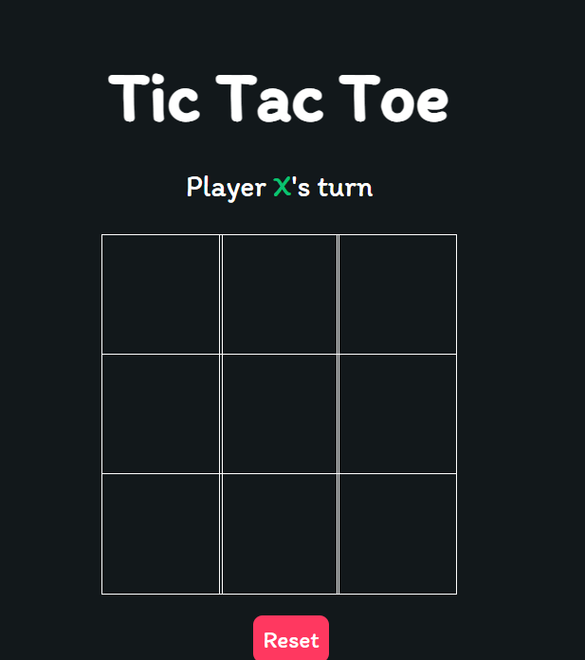
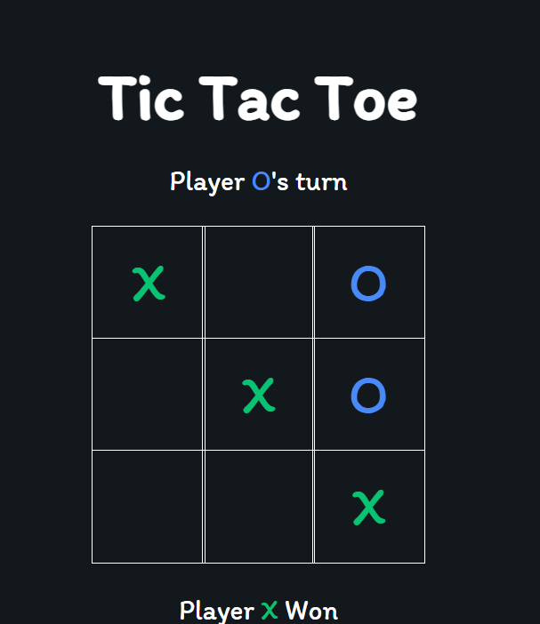
This is our Second Game Uploaded on our website .It Is Multiplayer Tic Tac Toe

Slide 18
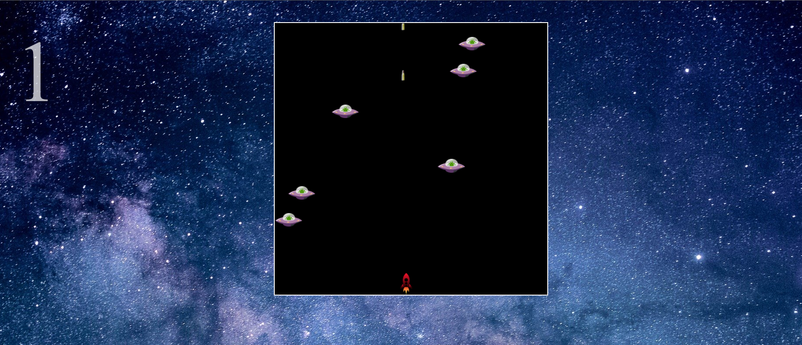
This is our Third Game Uploaded on our website also known as Space Shooter.

Slide 19
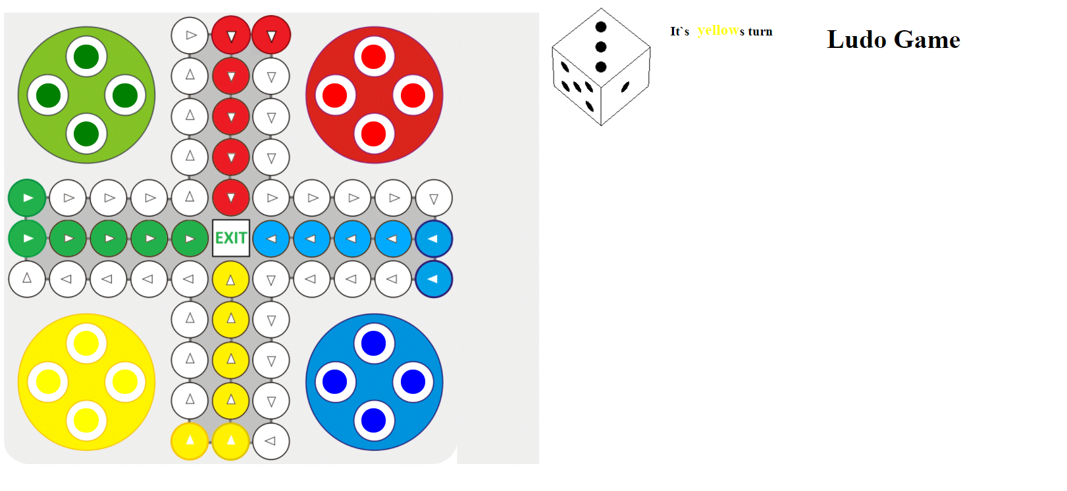
This is our Fourth Game Uploaded on our website also known as Ludo Game.

Slide 20
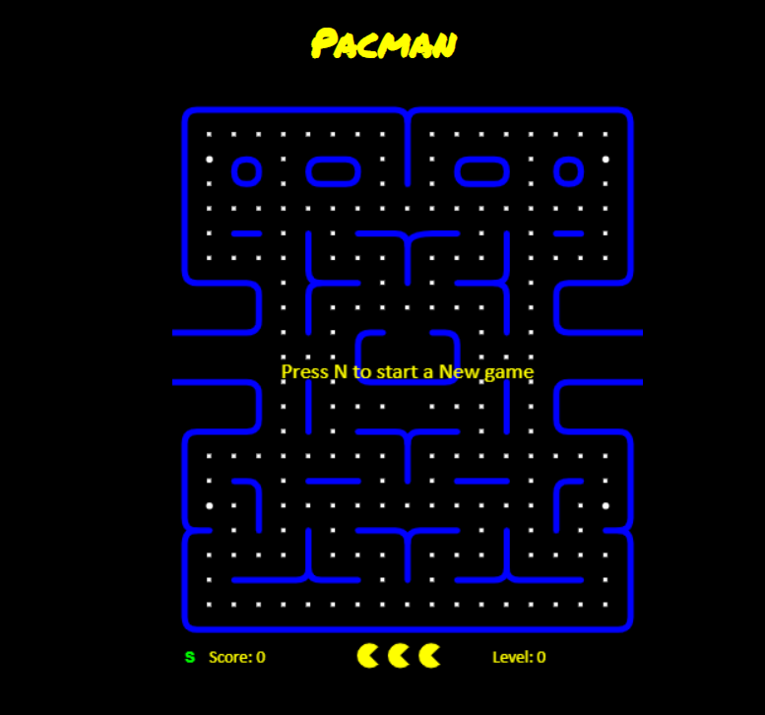
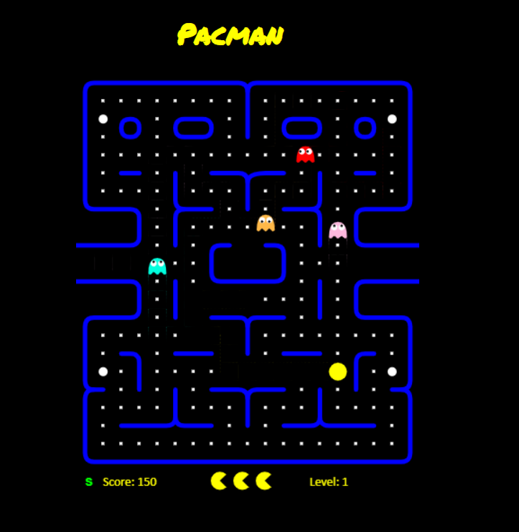
This is our Fifth Game Uploaded on our website also known as PACMAN GAME.
>>>

Slide 21
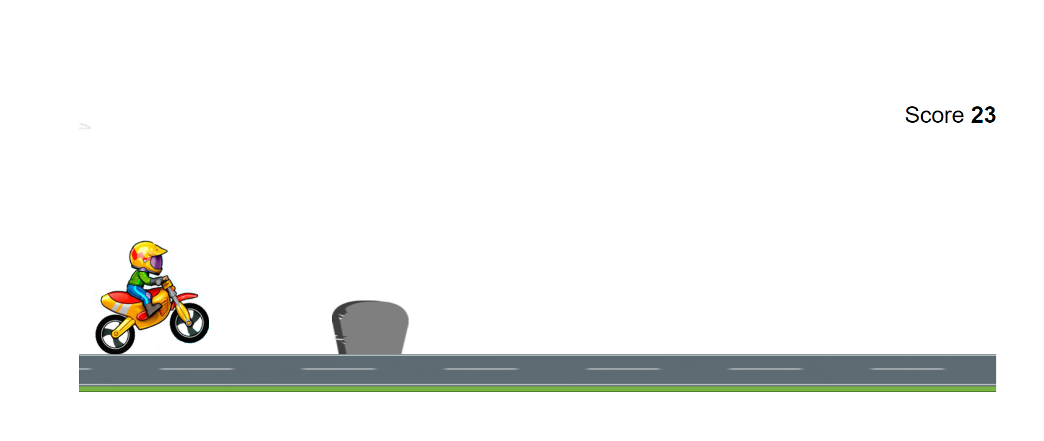
This is our Sixth Game Uploaded on our website also known as BIKER GAME.

Slide 22
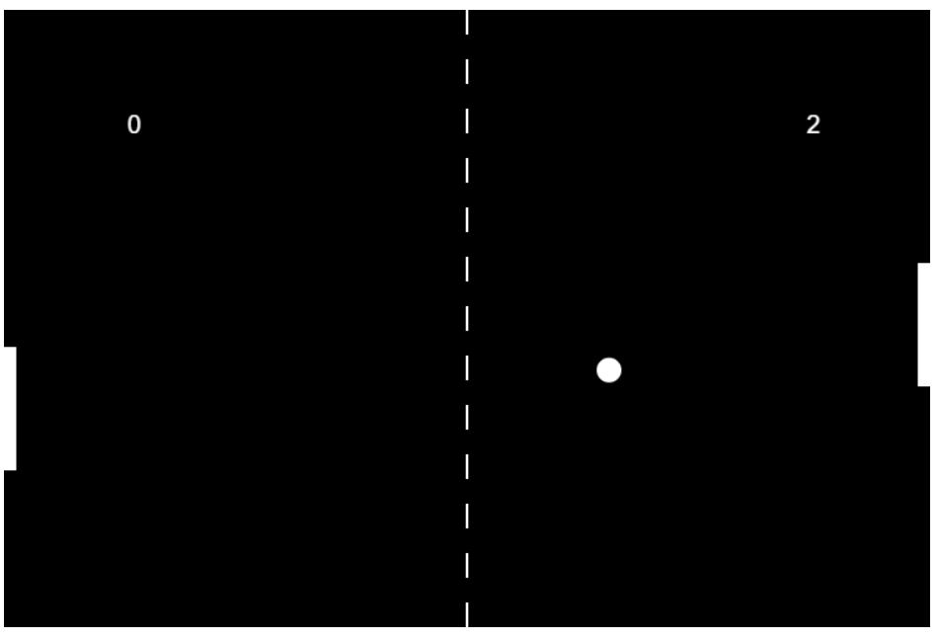
This is our Seventh Game Uploaded on our website also known as PING-PONG GAME.

Slide 23
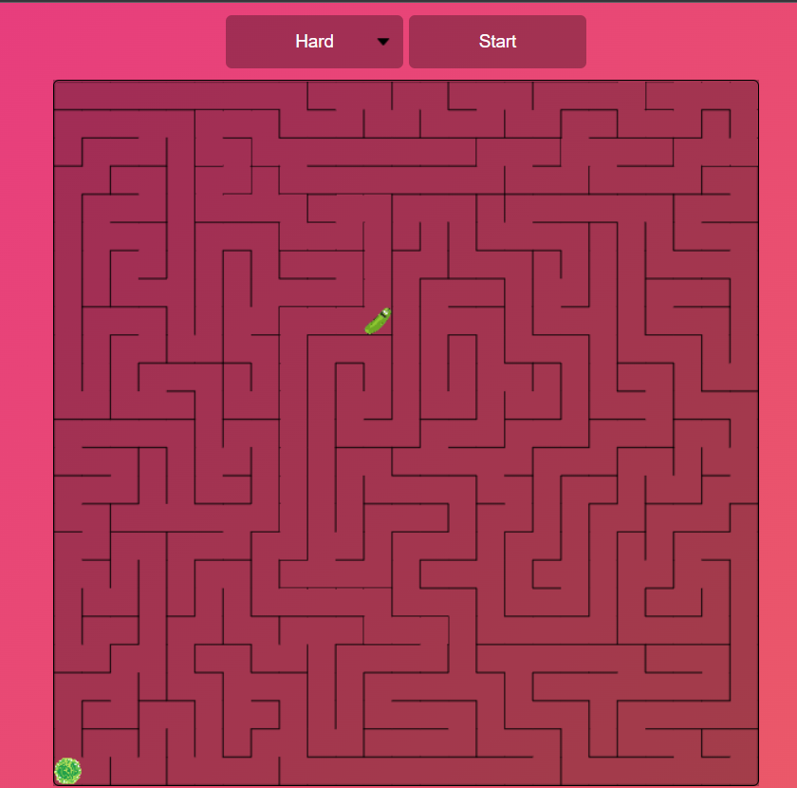
This is our Eight Game Uploaded on our website also known as MAZE GAME.

Slide 24
Link for the code: https://github.com/Mradul-06/ScriptingLanguage_Javascript_Project_layout
Link for the Gaming Website: https://slproject.netlify.app/

Slide 25
Conclusion
The future improvements can be made in certain areas of the project. There is scope for extending the project to incorporate more features by including more games with multiplayer option. Advanced messaging system with notification, etc. The process model selected is Agile model, so that the new options can be implemented to the same design in later point of time. The updating of the application is an important feature of agile process model designs.

Slide 26
Thank You!

